Slide 1

Artificial Neural Network: Introduction to the Basic Structure of a Neural network
Mina Farmanbar
Associate Professor, University of Stavanger
for engineers

Slide 2
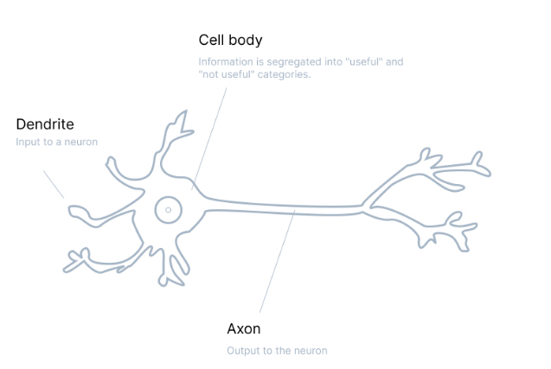
What is Human Neuron?
In a human neuron, information is received from dendrites.
All inputs are collected in the core and processed there.
Finally, the processed information leaves the neuron through the axon and synapses.
https://cdn.prod.website-files.com/5d7b77b063a9066d83e1209c/60d2412f8eda35fbd169d674_Group%20804.jpg

Slide 3
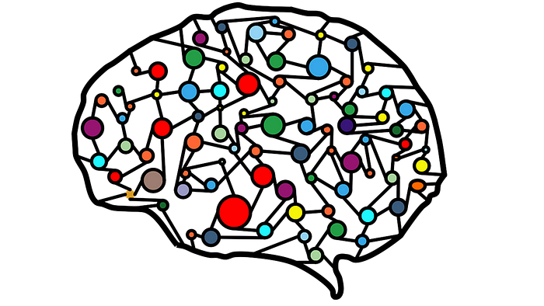
What is Neuron?
The artificial neuron is inspired by the structure of the natural neuron.
We are always looking for an algorithm that works like the brain or even better.
For this reason, an artificial neuron was created to imitate the natural neuron of the human brain.

Slide 4
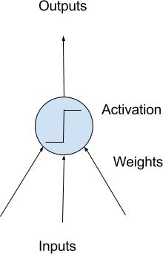
What is Artificial Neuron?
An artificial Neuron is a simple computational unit that has weighted input signals and produce an output signal using an activation function.
Model of a Simple Neuron,
known as perceptron

Slide 5
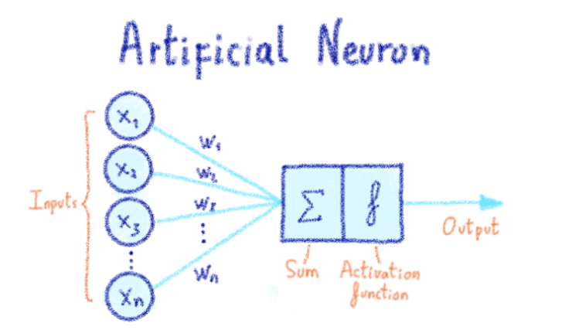
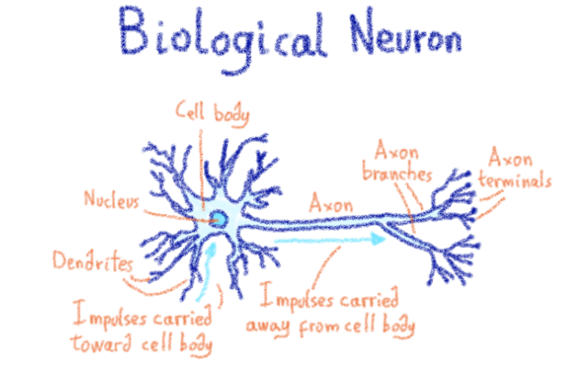
Biological Neuron vs. Artificial Neuron
https://miro.medium.com/v2/resize:fit:720/format:webp/1*tj-_jGgkxI3-wIdekhYOSw.png

Slide 6

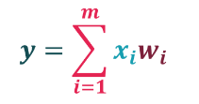
Mathematical model of Neuron
Well, we can easily write the structure of this neuron as follows:
Or we can make this a little more complicated. Instead of writing individual expressions, we can use the sigma symbol:
https://miro.medium.com/v2/resize:fit:720/format:webp/1*tj-_jGgkxI3-wIdekhYOSw.png

Slide 7
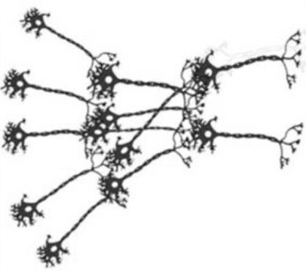
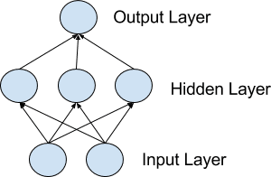
Networks of Neurons
Left: neural networks, Right: neurons in brain

Slide 8
Input or Visible Layers
The first layer that takes input from your dataset is called the visible/input layer.
Often a neural network is drawn with a visible layer with one neuron per input value or column in your dataset.

Slide 9
Hidden Layers
Layers after the input layer are called hidden layers.
Deep learning can refer to having many hidden layers in your neural network.

Slide 10
Output Layer
The final hidden layer is called the output layer
It is responsible for outputting a value or vector of values that correspond to the format required for the problem.

Slide 11
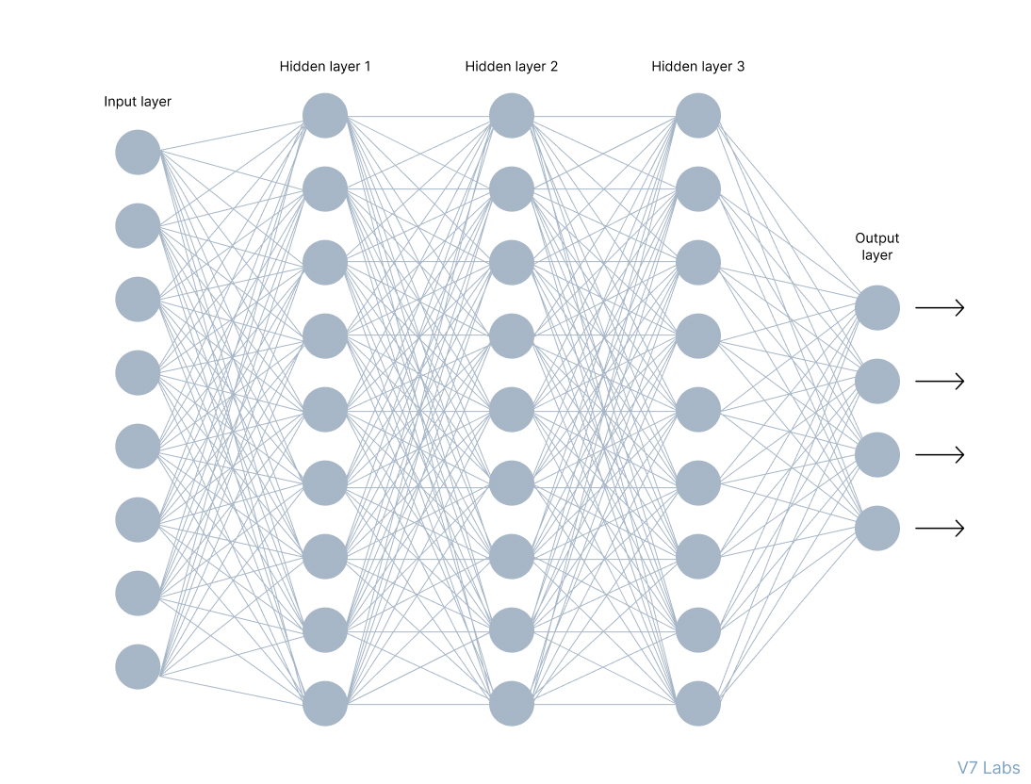
Multilayer Perceptron (MLP)
Many neurons are arranged as layers, and all neurons of one layer are connected to all neurons of another layer.
https://cdn.prod.website-files.com/5d7b77b063a9066d83e1209c/60d242974bcba9f8c670e03e_Group%20806.jpg

Slide 12
Artificial Neural Network
Three main topics associated with artificial neural networks:
Forward Propagation
Back Propagation
Activation Functions

Slide 13







Forward propagation
Forward propagation is the process through which data passes through layers of neurons in a neural network from the input layer all the way to the output layer.
$$x_{1}$$
$$w_{1}$$
$$z$$
$=x_{1}$.$w_{1}$ + $x_{2}$. $w_{2} \text{+}{ b}_{1}$
$$a=z$$
$$w_{2}$$
$$x_{2}$$
$$b_{1}$$

Slide 14






Forward propagation
$$x_{1}=0.1$$
$$z$$
$=x_{1}$.$w_{1}$ + ${ b}_{1}$
$$a=f(z)$$
$w_{1}$ = 0.15
$z=x_{1}$.$w_{1}$ + ${ b}_{1}$
$= 0.1 ∗ 0.15 + 0.40$
$$= 0.415$$
$$a = f(z)$$
= $\frac{1}{1+ e^{−z}}$ = $\frac{1}{1+ e^{−0.415}}$
$= 0.6023$
$b_{1}$ = 0.40
sigmoid function

Slide 15










Forward propagation
$$x_{1}=0.1$$
$$a_{1}=f(z)$$
$$z_{2}$$
$=a_{1}$.$w_{2}$ + ${ b}_{2}$
$$a_{2}=f(z)$$
$$z_{1}$$
$=x_{1}$.$w_{1}$ + ${ b}_{1}$
$w_{1}$ = 0.15
$w_{2}$ = 0.45
$b_{1}$ = 0.40
$b_{2}$ = 0.65
$z_{1}=x_{1}$.$w_{1}$ + ${ b}_{1}$
$= 0.1 ∗ 0.15 + 0.40$
$$= 0.415$$
$$a_{1}= f(z_{1})$$
= $\frac{1}{1+ e^{−z_{1}}}$
$= 0.6023$
$z_{2}=a_{1}$.$w_{2}$ + ${ b}_{2}$
$=0.6023 ∗ 0.45+ 0.65$
$$=0.9210$$
$$a_{2}= f(z_{2})$$
= $\frac{1}{1+ e^{−z_{2}}}$
$=0.7153$

Slide 16
Thank you!
Mina Farmanbar
mina.farmanbar@uis.no

